Slide 1

Presentation on hyperparameter tuning without using sci-kit learn
Presentation on hyperparameter tuning without using sci-kit learn
By – Md Anas patel

Slide 2
What is hyperparameter tuning?
A Machine Learning model is defined as a mathematical model with a number of parameters that need to be learned from the data. By training a model with existing data, we are able to fit the model parameters.
However, there is another kind of parameter, known as Hyperparameters, that cannot be directly learned from the regular training process. They are usually fixed before the actual training process begins. These parameters express important properties of the model such as its complexity or how fast it should learn.

Slide 3
hyperparameter tuning techniques
Grid Search
Randomized Search
Manual search
Halving Grid Search
Halving Randomized Search
HyperOpt-Sklearn
Bayes Search

Slide 4
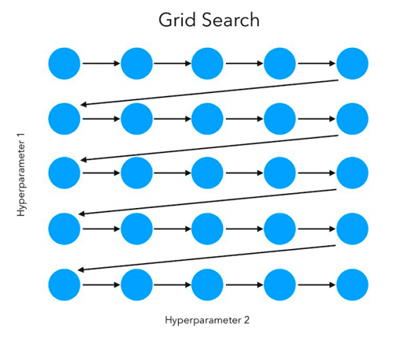
Gridsearchcv
GridSearchCV is a technique for finding the optimal parameter values from a given set of parameters in a grid. It’s essentially a cross-validation technique. The model as well as the parameters must be entered.

Slide 5
Advantages of gridsearchcv
Advantages: exhaustive search, will find the absolute best way to tune the hyperparameters based on the training set.
Disadvantages: time-consuming, danger of overfitting.

Slide 6
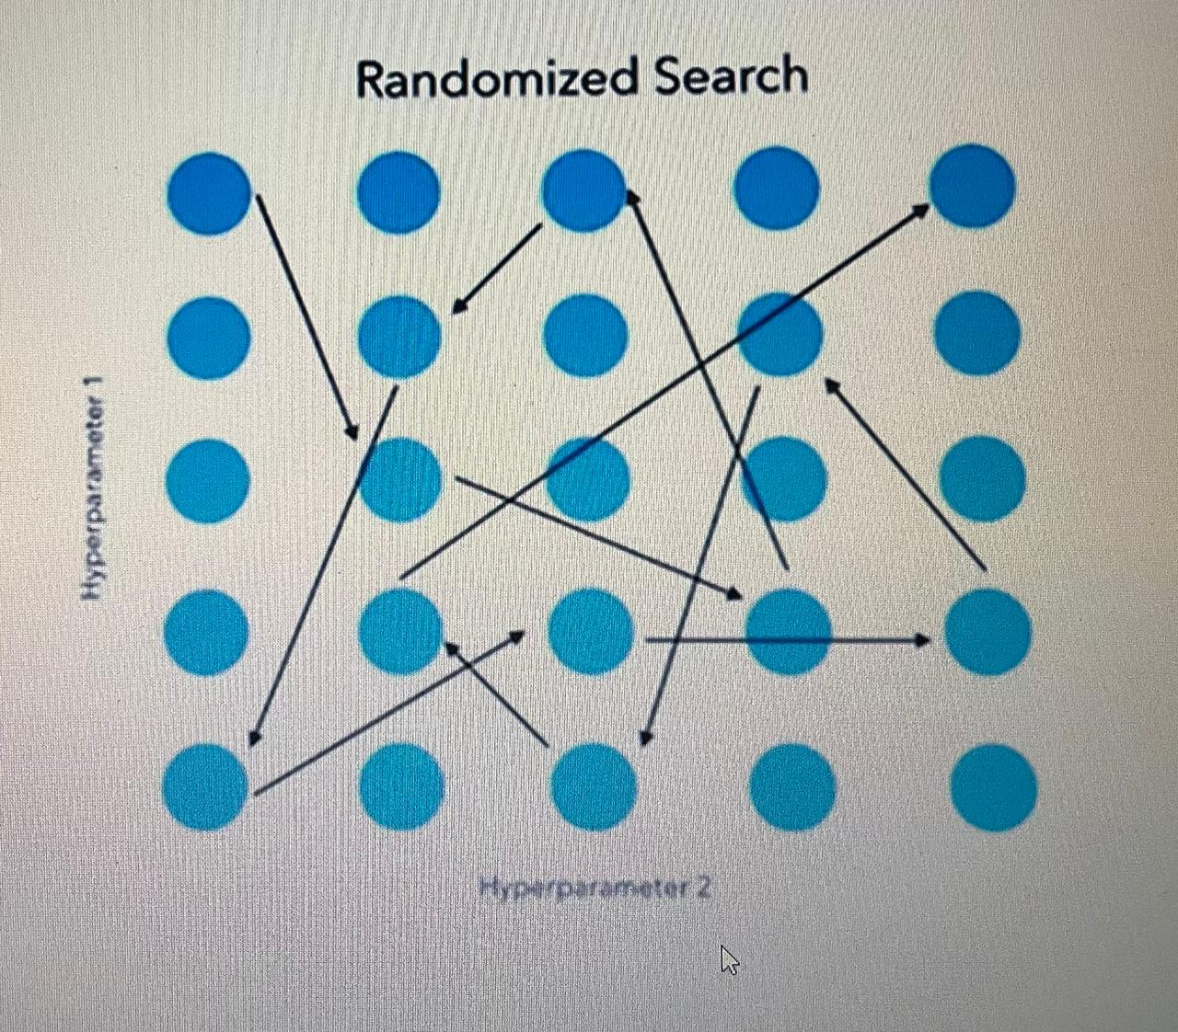
RandomizedSearchCV
RandomizedSearchCV randomly passes the set of hyperparameters and calculate the score and gives the best set of hyperparameters which gives the best score as an output.
Hyperparameter 2

Slide 7
Advantages of randomizedsearchcv
Advantages : It can try a broader range of values or hyperparameters within the same time.
Disadvantages : It doesn’t guarantee to give the best parameter combination because not all parameter values are tried out.

Slide 8
Fetch and Analyze the Data
Pre processing
Clean Data
Handle missing values
Building a Prediction Model
Splitting The data
Fitting The Model
Test The Model
RANDOMIZEDSEARCH
Param_dist
N_iter
Initialize best score and best params
N_iter loop randomly
MSE update
Print best hyperparameter
GRIDSEARCH
Hyperparameters [max_depth, min_sample_split]
Gridsearchcv Function
For loop to iterate possible combinations
Train the Model
Compute MSE
Best params and Best MSE
Print Best Combinations

